Slide 1

Management Information Systems: Managing the Digital Firm
Fifteenth edition
Chapter 14
Managing Projects

Slide 2
Runaway Projects and System Failure
Runaway projects: 30–40 percent IT projects
  Exceed schedule, budget
  Fail to perform as specified
Types of system failure
  Fail to capture essential business requirements
  Fail to provide organizational benefits
  Complicated, poorly organized user interface
  Inaccurate or inconsistent data

Slide 3

Figure 14.1: Consequences of Poor Project Management

Slide 4
Project Management Objectives
Project management
  Activities include planning work, assessing risk, estimating resources required, organizing the work, assigning tasks, controlling project execution, reporting progress, analyzing results
Five major variables
  Scope
  Time
  Cost
  Quality
  Risk

Slide 5
Management Structure for Information
Systems Projects
Corporate strategic planning group
  Responsible for firm’s strategic plan
Information systems steering committee
  Reviews and approves plans for systems in all divisions
Project management group
  Responsible for overseeing specific projects
Project team
  Responsible for individual systems project

Slide 6
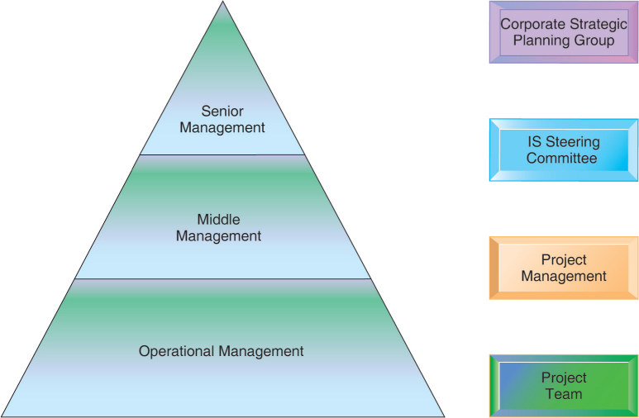
Figure 14.2: Management Control of Systems Projects

Slide 7
Information Systems Plan (1 of 2)
Identifies systems projects that will deliver most business value
Links development to business plan
Road map indicating direction of systems development, includes:
  Purpose of plan
  Strategic business plan rationale
  Current systems/situation
  New developments
  Management strategy
  Implementation plan
  Budget

Slide 8
Information Systems Plan (2 of 2)
For effective plan
  Document existing systems and infrastructure components
  Identify decision-making improvements
  Develop metrics established for quantifying values
  Clear understanding of long-term and short-term information requirements
Key performance indicators (KPIs)
  Strategic analysis identifies small number of KPIs, determined by managers

Slide 9
Portfolio Analysis
Used to evaluate alternative system projects
Inventories all of the organization’s information systems projects and assets
Each system has profile of risk and benefit
  High benefit, low risk
  High benefit, high risk
  Low benefit, low risk
  Low benefit, high risk
To improve return on portfolio, balance risk and return from systems investments

Slide 10
Scoring Models
Used to evaluate alternative system projects, especially when many criteria exist
Assigns weights to various features of system and calculates weighted totals
Many qualitative judgments involved
Requires experts who understand the issues and the technology

Slide 11
Table 14.2 Example of a Scoring Model for an ERP System
CRITERIA | WEIGHT | ERP SYSTEM A % | ERP SYSTEM A SCORE | ERP SYSTEM B % | ERP SYSTEM B SCORE
1.1 Online order entry | 4 | 67 | 268 | 73 | 292
1.2 Online pricing | 4 | 81 | 324 | 87 | 348
1.3 Inventory check | 4 | 72 | 288 | 81 | 324
1.4 Customer credit check | 3 | 66 | 198 | 59 | 177
1.5 Invoicing | 4 | 73 | 292 | 82 | 328
2.1 Production forecasting | 3 | 72 | 216 | 76 | 228
2.2 Production planning | 4 | 79 | 316 | 81 | 324
(etc.) | (etc.) | (etc.) | (etc.) | (etc.) | (etc.)
GRAND TOTALS | - | - | 3,128 | - | 3,300

Slide 12
Information System Costs and Benefits
Tangible benefits
  Can be quantified and assigned monetary value
  Systems that displace labor and save space:
    Transaction and clerical systems
Intangible benefits
  Cannot be immediately quantified but may lead to quantifiable gains in the long run
    For example, more efficient customer service, enhanced decision making
  Systems that influence decision making:
    ESS, DSS, collaborative work systems

Slide 13
Capital Budgeting for Information Systems
Capital budgeting models
  Measure value of long-term capital investment projects
  Rely on measures of the firm’s cash outflows and inflows
Principle capital budgeting models used to evaluate IT projects
  Payback method
  Accounting rate of return on investment (ROI)
  Net present value
  Internal rate of return (IRR)
Limitations of financial models

Slide 14
Dimensions of Project Risk
Project size
  Cost
  Time
  Number of organizational units affected
  Organizational complexity
Project structure
  Structured, defined requirements run lower risk
Experience with technology
  Team familiar with hardware and software

Slide 15
Interactive Session: Management: Can the National Health Service Go Paperless?
Class discussion
  Why is paperless NHS a risky project? Identify the key risk factors.
  What management, organization, and technology problems is the paperless NHS likely to encounter?
  What steps should be taken to make the paperless NHS more successful?

Slide 16
Change Management and the Concept of
Implementation (1 of 2)
Change management
  Required for successful system building
  New information systems have powerful behavioral and organizational impact
Implementation
  All organizational activities working toward adoption, management, and routinization of an innovation
Change agent
  One role of systems analyst
  Redefines the configurations, interactions, job activities, and power relationships of organizational groups

Slide 17
Change Management and the Concept of
Implementation (2 of 2)
Role of end users
  With high levels of user involvement
    System more likely to conform to requirements
    Users more likely to accept system
User–designer communication gap
  Users and information systems specialists
Management support and commitment
  Effects positive perception by both users and technical staff
  Ensures sufficient funding and resources
  Helps enforce required organizational changes

Slide 18
Change Management Challenges for Business Process Reengineering, Enterprise Applications, and Mergers and Acquisitions
Very high failure rate among enterprise application and BPR projects (up to 70 percent for BPR)
  Poor implementation and change management practices
    Employee concerns about change
    Resistance by key managers
    Changing job functions, career paths, recruitment practices
Mergers and acquisitions
  Similarly high failure rate of integration projects
  Merging of systems of two companies requires:
    Considerable organizational change, complex systems projects

Slide 19
Controlling Risk Factors
First step in managing project risk involves identifying nature and level of risk of project.
Each project can then be managed with tools and risk-management approaches geared to level of risk.
Managing technical complexity
  Internal integration tools
    Project leaders with technical and administrative experience
    Highly experienced team members
    Frequent team meetings
    Securing of technical experience outside firm if necessary

Slide 20
Formal Planning and Control Tools
Used for documenting and monitoring project plans
Help identify bottlenecks and impact of problems
Gantt charts
  Visual representation of timing and duration of tasks
  Human resource requirements of tasks
PERT charts
  Graphically depict tasks and interrelationships
  Indicate sequence of tasks necessary

Slide 21
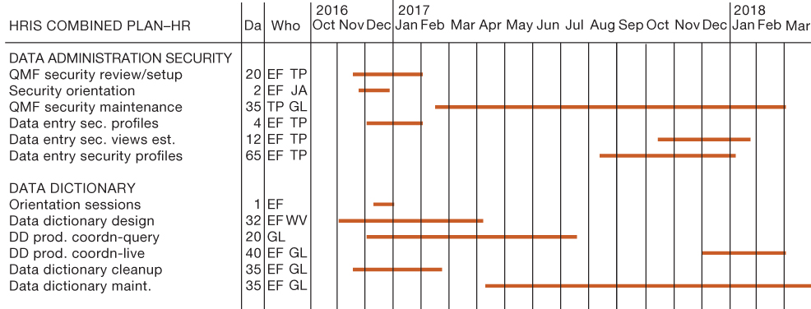
Figure 14.4: A Gantt Chart (1 of 3)

Slide 22
Increasing User Involvement and Overcoming User Resistance
External integration tools
  Link work of implementation team to users at all levels
User resistance to organizational change
  Counterimplementation
Strategies to overcome user resistance
  User participation, education and training
  Management edicts and policies
  Incentives for cooperation
  Improvement of end-user interface
  Resolution of organizational problems prior to introduction of new system

Slide 23
Designing for the Organization
Need to address ways in which organization changes with new system
Ergonomics
  Interaction of people and machines in work environment
Organizational impact analysis
  How system will affect organizational structure, attitudes, decision making, operations
Sociotechnical design
  Addresses human and organizational issues

Slide 24
Project Management Software Tools
Can automate many aspects of project management
Capabilities for defining, ordering tasks
  Assigning resources to tasks, tracking progress
  Manage very large numbers of tasks and relationships
Microsoft Project
Cloud-based software
Project portfolio management software

Slide 25
End

